Slide 1
Impact of COVID pandemic on Air Navigation Service Providers – European Level and Case study Bulgaria
15 SEPTEMBER 2022
SOFIA, BULGARIA

Slide 2
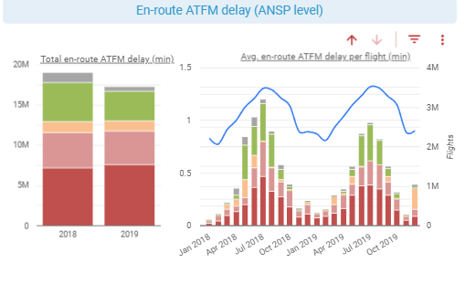
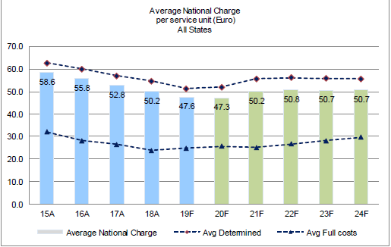
SETTING THE SCENE OVER RP2 2015-2019 AND RP3 2020-2024
NOV 2019: TRAFFIC RUNNING AT FULL THROTTLE, MORE CAPACITY OVER RP3 IS OF ESSESENCE

Slide 3
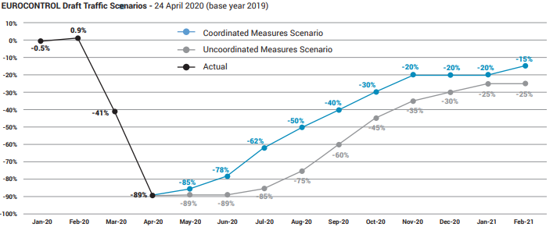
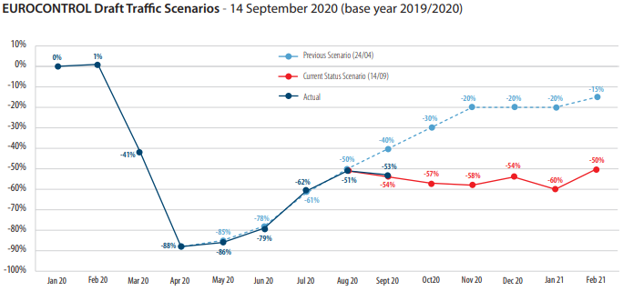
SETTING THE SCENE OVER RP2 2015-2019 AND RP3 2020-2024
2020:COMPLETE HALT… QUO VADIS … WILL TRAFFIC BE EVER COMING BACK?
Uncertain legislative perspective: Performance Scheme – Y/N? New EU-wide targets or full cost recovery? ANSP costs and losses? ANSPs capabilities to generate revenue? State aid? Liquidity, low unit rates, charges deferral? Investments and ATCOs recruitment?

Slide 4
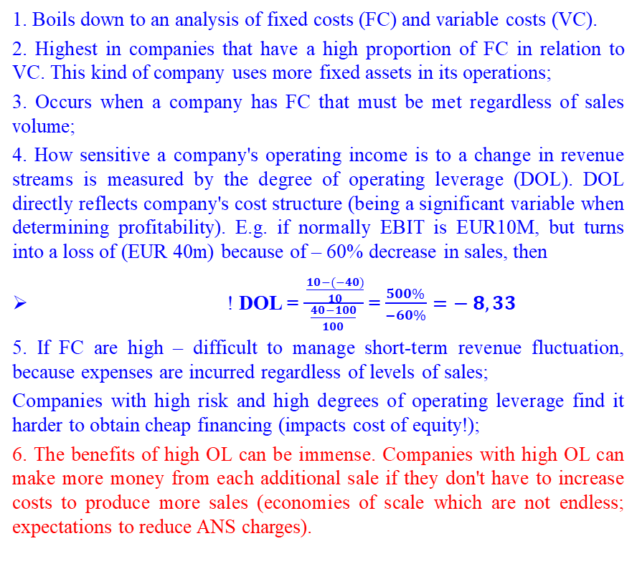
ANSPs FEATURES AND ENDOGENOUS CHARACTERISTICS
High operating leverage (OL) – main reasons: 24/7 operations and the need for meeting all requirements to ensure safety regardless of traffic levels
Long minimal planning horizon 5 to 10 years – main reasons: complex projects and time-consuming training processes; needed to ensure safety
1. Boils down to an analysis of fixed costs (FC) and variable costs (VC).
2. Highest in companies that have a high proportion of FC in relation to VC. This kind of company uses more fixed assets in its operations;
3. Occurs when a company has FC that must be met regardless of sales volume;
4. How sensitive a company's operating income is to a change in revenue streams is measured by the degree of operating leverage (DOL). DOL directly reflects company's cost structure (being a significant variable when determining profitability). E.g. if normally EBIT is EUR10M, but turns into a loss of (EUR 40m) because of – 60% decrease in sales, then
! DOL = $\frac{ \frac{10−(−40)}{10}}{\frac{40−100}{100}}$ = $\frac{500\%}{−60\%}=− 8,33$
5. If FC are high – difficult to manage short-term revenue fluctuation, because expenses are incurred regardless of levels of sales;
Companies with high risk and high degrees of operating leverage find it harder to obtain cheap financing (impacts cost of equity!);
6. The benefits of high OL can be immense. Companies with high OL can make more money from each additional sale if they don't have to increase costs to produce more sales (economies of scale which are not endless; expectations to reduce ANS charges).
1. ATCO training period – 2-4 years
2. ATM/CNS projects are complex and time consuming > 2 years if R&D is heavily involved
3. Planning horizon ≥ 5 years, 5-10 years
CONCLUSIONS:
ANSPs must find ways to acquire human and technical resources to meet high traffic demand in more flexible ways (Operational resilience)
ANSPs must find ways to manage activities and costs in more flexible ways (Financial resilience)
ANSPs must act in preventive manner with sufficient lead time
Medium- and long-term objectives for ANSPs prevail over short-term objectives

Slide 5
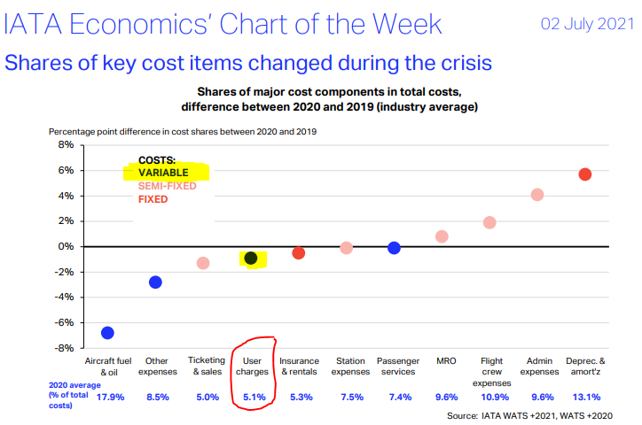
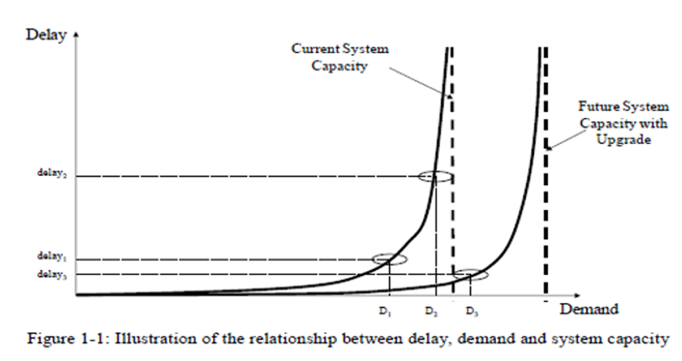
RESILIENCE OF ANSPs – LINKS TO CHARGES
ANSP PERSPECTIVE
USERS/AIRLINES PERSPECTIVE
1. Charges comprise almost 100% of ANSP income, as a rule
2. Bear all costs for human and technical resources to ensure service provision, maintenance and development of critical infrastructure
3. No commitment on users’ side for traffic volume, thus mechanisms to offset variances between forecasted and actual traffic are in place
4. Regulation and applicable legislation have to ensure legal certainty and ability to generate revenue (different than overcoming liquidity issues)
5. Must prioritise medium-and long-term objectives over short-terms ones in a cost-efficient manner. This would not change users' cost structure and would be “bearable“ compared to daily problems related to unsafe and low-quality service provision, especially when traffic is high.
6. Focus on meaningful interdependency concept and total economic costs of service provision (SAF, CAP, ENV, CEF)
7. Actions are to be taken in preventive manner
1. ANS charges comprise some 5% of airlines costs
2. Charges have to encourage the use of ANS facilities and services
3. Pay via user charges for the use of service provision and critical infrastructure only when actively flying (thus, should it be expected that ANS charges be covered by passengers/cargo clients’ money, as a rule?)
4. Not asked to finance service provision when flights are not performed but asked to cover ANSP losses because of lower than planned charges (when demand is back)

Slide 6
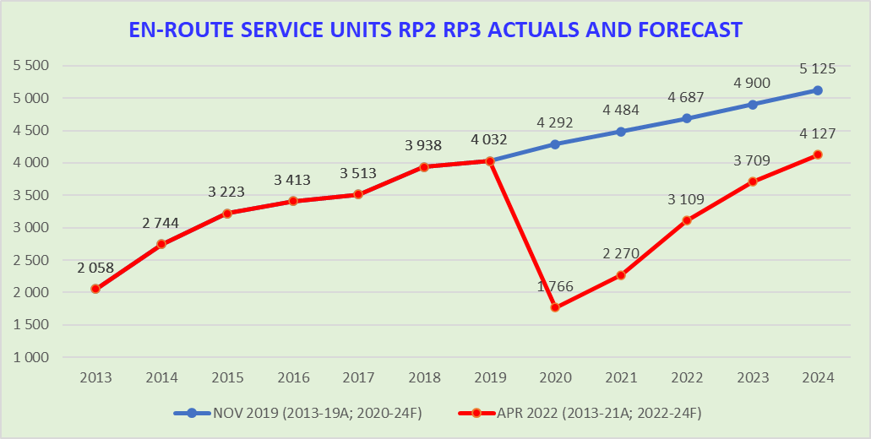
BULATSA CASE STUDY
RP2 DEVELOPMENT
RP3 DEVELOPMENT
1. 2013: ~ 500,000 flights; 2019 : ~ 900,000 flights; SU doubled
2. Lack of clarity on the use of Simferopol FIR and Dnipropetrovsk FIR airspaces given the ease of regulatory bans (BIG Impact)
3. Uncertainty related to Iraq/Iran/Syrian airspaces (BIG Impact)
4. Increased complexity of operations (X-MAN for LTFM)
5. Application of and focus on meaningful interdependency concept and total economic costs of service provision (SAF, CAP, ENV, CEF)
6. Actions taken in preventive manner
7. Intensive measures: very flexible ATCOs roster (up to 22 shifts), cross training
8. Extensive measures: recruitment of additional ATCOs, new investments
9. En-route unit rate (EUR): about 30;
10. Revision of RP2 PP and ZERO delays
1. 2020: ~ 380,000 flights; 2021 ~ 520,000 flights; SU halved
2. Lack of clarity on the use of Simferopol FIR and Dnipropetrovsk FIR airspaces given the ease of regulatory bans (BIG Impact)
3. Increased uncertainty related to Iraq, Iran, Syria, Afghanistan, (Nagorno- Karabakh conflict) airspaces (BIG Impact)
4. Application of and focus on meaningful interdependency concept and total economic costs of service provision (SAF, CAP, ENV, CEF)
5. Actions taken in preventive manner
6. Measures to limit spread of COVID-19 among operational and administrative staff. ATCOs organised in teams, part of ATCOs allocated to work on projects
7. Immediate salaries cut from March 2020 for all staff by 30% - applied for more than 24 months. All performance related payments under the collective labour agreement were also ceased
8. All operating costs limited to those necessary to maintain operations, only
9. Investments prioritised to safety and capacity critical projects & such that were well advanced and could not be stopped
10. Preservation of full BULATSA potential to provide services
11. En-route unit rate (EUR) - 2020/21: 28.60/28.61; 2022-24: about 35 EUR
12. ZERO DELAY so far over RP3
13. Approval of draft RP3 PP in April 2022
14. Copying with the crisis on our own (NO FINANCIAL STATE AID NOR LOANS).
LESSONS FROM RP2 AND RP3: BULATSA provided ANS under extreme operational and financial conditions over RP2 and RP3. This has been done so far at zero delays and at zero external financial assistance (0 state aid, grants and loans), while applying one of the lowest en-route unit rates in Europe. Such achievements were facilitated by management decisions but were also facilitated by flexible and legally certain law at EU level adopted in 2016 and 2020.

Slide 7

RESILIENCE – LESSONS LEARNED AND WHAT IS NEXT?
FROM AA (AIRLINES AND ANSPs) TO AAA (AIRLINES, ANSPs AND AIRPORTS)
Whatever we do together as airlines and ANSPs (AA) must be within the legal framework
Therefore, when legislation is designed, it must:
    provide for legal certainty
    be balanced and recognise clearly that safety requirements are to be met (and that this comes at cost)
    encourage prevention of problems rather than finding a solution for them (usually this is more cost-efficient way)
    reflect properly AA’ business models, fundamentals of their economics and associated risks
    take well into account time, ways of interactions and the levels of dependence and interdependence between AA
    help most in the hour of need but to facilitate and encourage development in the times of boom taking into account structural features of AA
    ensure sufficient possibilities for generating revenue. and sufficient liquidity for AA
    reflect properly interdependencies and key performance areas within ANSPs and airlines
    encourage service provision and the use of such facilities and services
    C. Airways are built for adding capacity, but what about runways? Can we move from AA service provision to AAA without airports?

Slide 8
RESILIENCE
    THANK YOU FOR YOUR ATTENTION
    QUESTIONS?

